Slide 1

Algebra 1
Unit 13, Lesson 1 Simple Interest Volume 2, pg. 235

Slide 2


Benchmarks
MA.9.12.FL.3.2
Solve real-world problems involving simple, compound, and continuously compounded interest.
MA.9.12.FL.3.4
Explain the relationship between simple interest and linear growth. Explain the relationship between compound interest and exponential growth, and the relationship between continuously compounded interest and exponential growth.
MA.9.12.FL.1.8
Determine whether a linear, quadratic, or exponential function best models a given real-world situation.
volume 2, pg. 235

Slide 3
Integrated Mathematical Thinking and Reasoning Standards
MA.K12.MTR.2.1 Demonstrate understanding by representing problems in multiple ways.
MA.K12.MTR.4.1 Engage in discussions that reflect on the mathematical thinking of self and others.
MA.K12.MTR.5.1 Use patterns and structure to help understand and connect mathematical concepts.
MA.K12.MTR.7.1 Apply mathematics to real-world contexts.
volume 2, pg. 235

Slide 4

Learning Targets
I can explain the relationship between simple interest and linear growth.
I can solve real-world problems involving simple interest.
volume 2, pg. 235

Slide 5

Warm-Up
volume 2, pg. 235

Slide 6
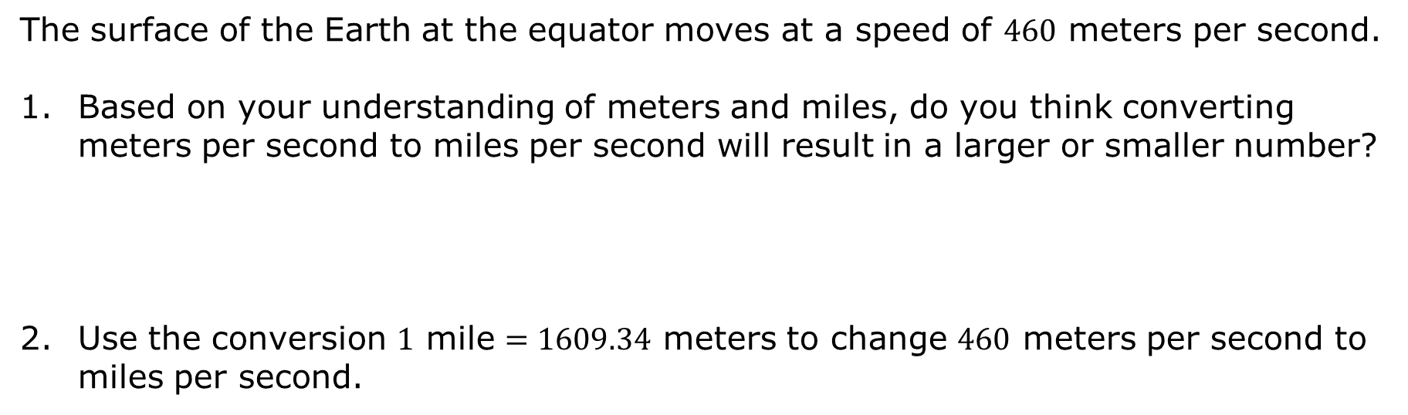
13.1.1 Warm-Up: Earth’s Surface Speed
The surface of the Earth at the equator moves at a speed of $460$ meters per second.
Based on your understanding of meters and miles, do you think converting meters per second to miles per second will result in a larger or smaller number?
Use the conversion $1$ mile $=1609.34$ meters to change $460$ meters per second to miles per second.
volume 2, pg. 235

Slide 7
Use the conversion $1$ hour $=3600$ seconds to determine the speed of the surface of the Earth in miles per hour.
volume 2, pg. 235

Slide 8

Guided Instruction
volume 2, pg. 236

Slide 9
13.1.2 Guided Instruction: Simple Interest
When money is borrowed or saved, interest is typically accrued. For example, if money is borrowed, the interest accrued is owed in addition to the amount borrowed. If money is saved in an interest-bearing account, the interest accrued is saved in addition to the funds deposited into the account.
Simple interest is calculated by using three quantities — the principal, which could be an amount borrowed or an amount invested; the rate of interest; and the time period it will cover.
Student loans and mortgages typically use simple interest, whereas savings accounts and credit card debt typically use compound interest.
volume 2, pg. 236

Slide 10
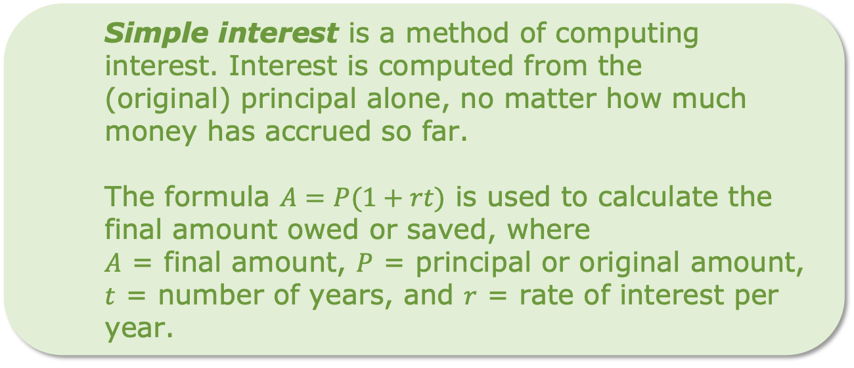

volume 2, pg. 236

Slide 11
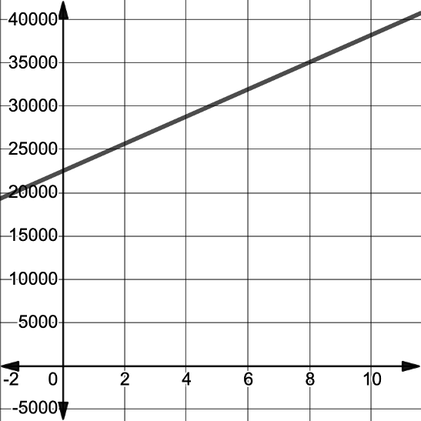
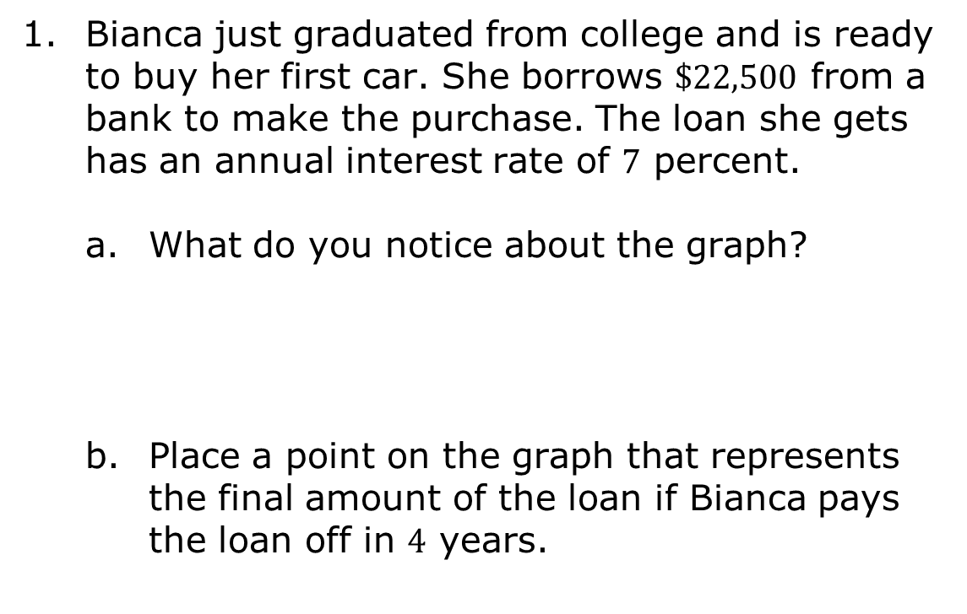
Bianca just graduated from college and is ready to buy her first car. She borrows $\$22,500$ from a bank to make the purchase. The loan she gets has an annual interest rate of $7$ percent.
What do you notice about the graph?
Place a point on the graph that represents the final amount of the loan if Bianca pays the loan off in $4$ years.
volume 2, pg. 236

Slide 12
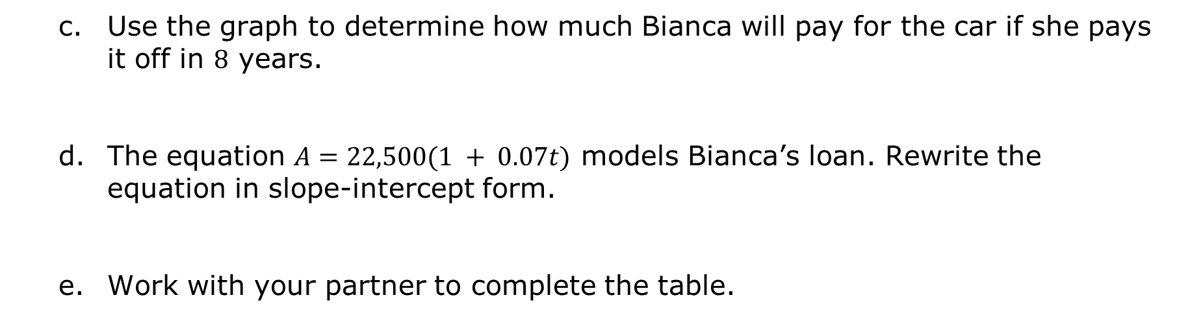
Use the graph to determine how much Bianca will pay for the car if she pays it off in $8$ years.
The equation $A=22,500(1 + 0.07t)$ models Bianca’s loan. Rewrite the equation in slope-intercept form.
Work with your partner to complete the table.
Key Feature | Value | Interpretation in Context
𝒚-intercept
slope
volume 2, pg. 236

Slide 13
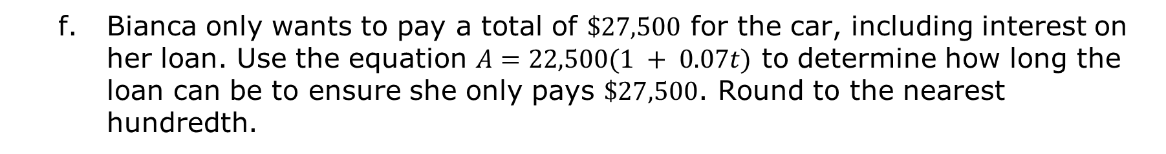
Bianca only wants to pay a total of $\$27,500$ for the car, including interest on her loan. Use the equation $A=22,500(1 + 0.07t)$ to determine how long the loan can be to ensure she only pays $\$27,500$. Round to the nearest hundredth.
volume 2, pg. 237

Slide 14

In 2001, Logan’s parents had $\$1,500$ to invest. They chose a certificate of deposit that offered a $5\%$ annual percentage rate (APR).
Work with your partner to write an equation that models his parents’ deposit using the formula $A=P(1 + rt)$, where $A=$ final amount, $P=$ principal or original amount, $t=$ number of years, and $r=$ rate of interest per year.
A certificate of deposit (CD) is a type of savings account offered by banks and credit unions that provides a higher interest rate in exchange for the customer agreeing to leave a lump-sum deposit untouched for a predetermined period of time.
volume 2, pg. 237

Slide 15
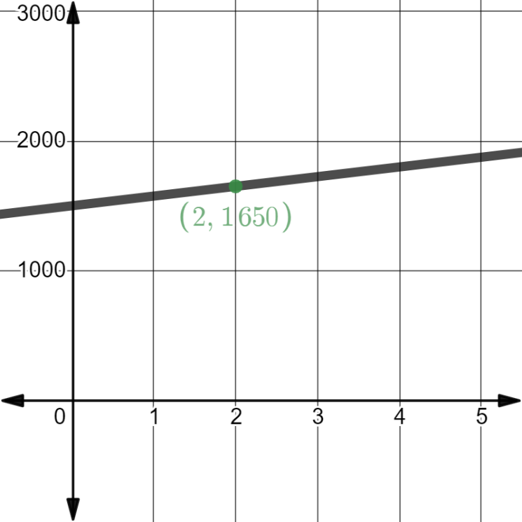
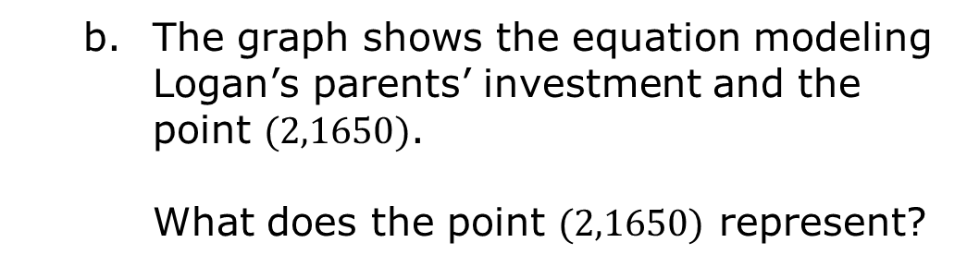
The graph shows the equation modeling Logan’s parents’ investment and the point $(2,1650)$.
What does the point $(2,1650)$ represent?
volume 2, pg. 238

Slide 16
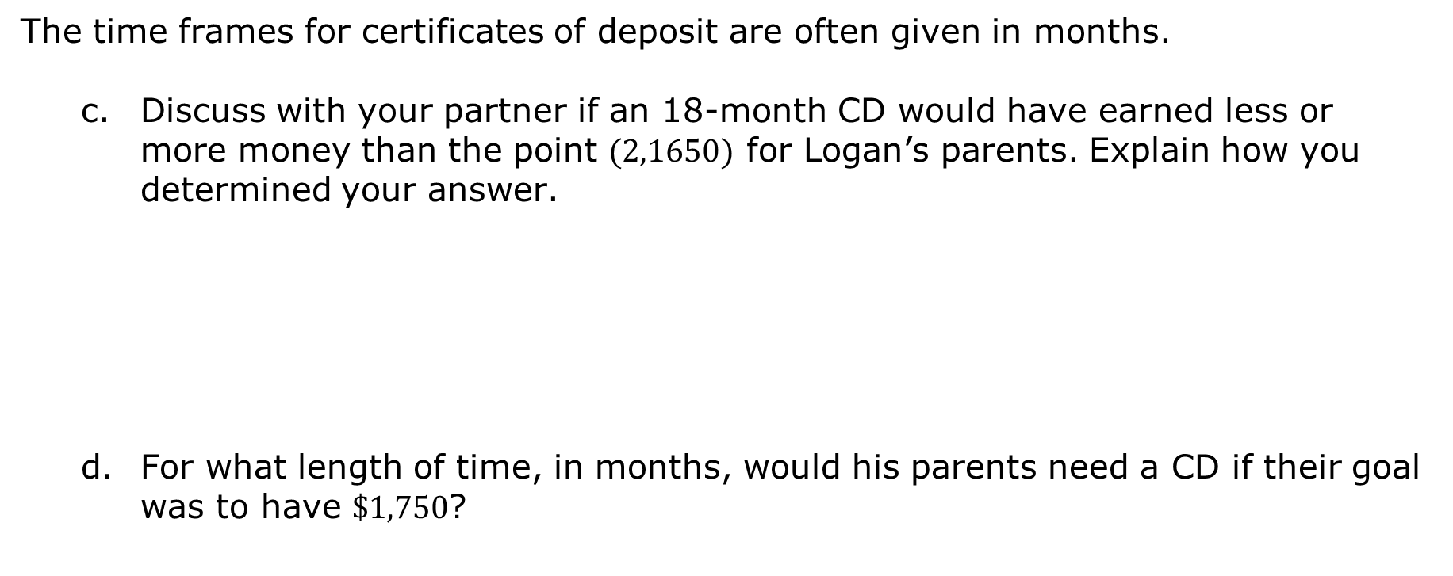
The time frames for certificates of deposit are often given in months.
Discuss with your partner if an 18-month CD would have earned less or more money than the point $(2,1650)$ for Logan’s parents. Explain how you determined your answer.
For what length of time, in months, would his parents need a CD if their goal was to have $\$1,750$?
volume 2, pg. 238

Slide 17
Complete the table for simple interest relationships.
Key Feature | Description
End Behavior | As 𝒙→∞, 𝒚→______
Increasing/Decreasing | As 𝒙 increases, 𝒚→______
volume 2, pg. 238

Slide 18
Discuss with your partner how the key features of end behavior and intervals where the function is increasing/decreasing help to explain the relationship between simple interest and linear growth. Summarize your discussion.
What other key feature is useful to explain that simple interest is modeled by linear growth?
volume 2, pg. 239

Slide 19

Guided Practice
volume 2, pg. 239

Slide 20

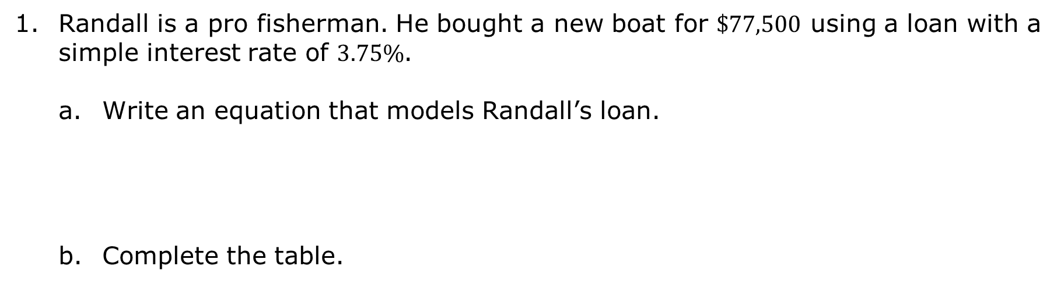
13.1.3 Guided Practice: Calculating Simple Interest
Randall is a pro fisherman. He bought a new boat for $\$77,500$ using a loan with a simple interest rate of $3.75\%$.
Write an equation that models Randall’s loan.
Complete the table.
Key Feature | Value | Interpretation in Context
𝒚-intercept
slope
volume 2, pg. 239

Slide 21
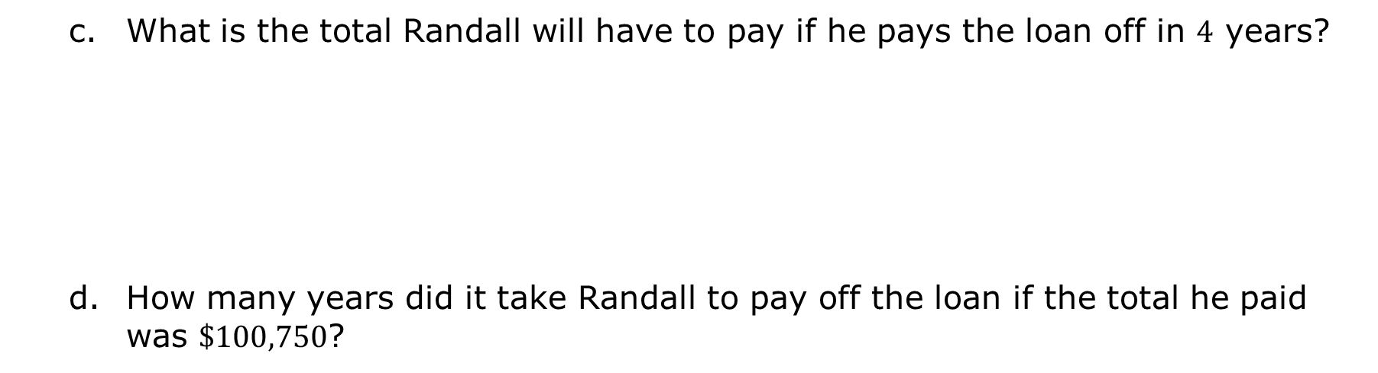
What is the total Randall will have to pay if he pays the loan off in $4$ years?
How many years did it take Randall to pay off the loan if the total he paid was $\$100,750$?
volume 2, pg. 239

Slide 22

Your Turn
volume 2, pg. 240

Slide 23

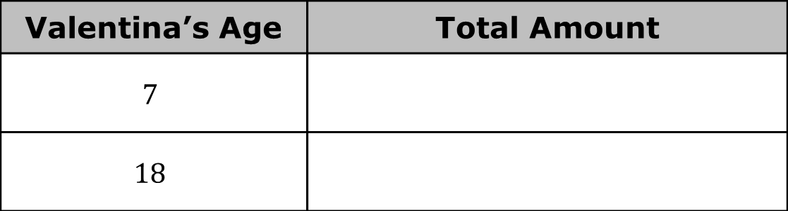
13.1.4 Your Turn!
When Valentina was born, her grandmother put $\$2,500$ into a savings account for her. The savings account had a $2.25\%$ interest rate. Each year on her birthday, her grandmother told her how much money was in the account.
Complete the table. Show your work.
How old will Valentina be when the account has reached $\$4,000$?
Valentina’s Age | Total Amount
$$7$$
$$18$$
volume 2, pg. 240

Slide 24

Wrap-Up
volume 2, pg. 240

Slide 25

13.1.5 Wrap-Up: Reflection
Take a SELFIE by checking the box that best matches what you did today.
Showed my work
Explained my answers
Lots of math vocabulary used
Found solutions
I persevered through the problem
Eliminated careless errors
volume 2, pg. 240

